Slide 1
Moving Beyond Linearity:
Regression Splines
Team 15
Michael Uhrig , Lydia Zhao, Leyi Wen, Aaron Liu

Slide 2

Review of Step Functions & Polynomial Regressions
Piecewise Polynomials
Discussion of Degrees of Freedom
Adding Constraints and Regression Splines
Spline Basis Representation
Natural Splines
Choosing Number and Locations of the Knots
Regression Splines v.s. Polynomial Regression
Code Exercise

Slide 3
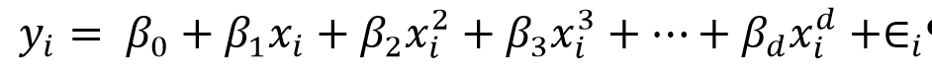
Review: Polynomial Regression
Recall that we are in a one-predictor case here!
For large enough degree d, a polynomial regression allows us to produce an extremely non-linear curve.
Generally avoid using d greater than 3 or 4
For large values of d, the polynomial curve can become overly flexible and can take on some very strange shapes.

Slide 4
Review: Step Functions
Using polynomial functions imposes a single functional form on the entire subspace spanned by the predictors
Use step functions to break the range of X into bins, and fit a different constant in each bin. (“piecewise-constant’ approach)
This amounts to converting a continuous variable into an ordered categorical variable.

Slide 5
Review: Basis Functions
The idea is to have at hand a family of functions or transformations that can be applied to a variable X: b₁(X), b₂(X), ... ,b_{K}(X).
General form is as shown:
Polynomial and piecewise-constant regression models are special cases of a basis function approach.
Regression splines are another very common choice for a basis function.

Slide 6
Regression Splines: Piecewise Polynomials
Instead of fitting a high-degree polynomial over the entire range of X, piecewise polynomial regression involves fitting separate low-degree polynomials over different regions of X.
For example, a piecewise cubic polynomial works by fitting a cubic regression model of the form where the coefficients β₀, β₁, β₂, and β₃ differ in different parts of the range of X. The points where the coefficients change are called knots.

Slide 7

Regression Splines: Piecewise Polynomials
For example, a piecewise cubic with no knots is just a standard cubic polynomial, with d = 3. A piecewise cubic polynomial with a single knot at a point c takes the form
In other words, we fit two different polynomial functions to the data, one on the subset of the observations with x_{i} < c, and one on the subset of the observations with x_{i} ≥ c.
Each of these polynomial functions can be fit using least squares applied to simple functions of the original predictor.

Slide 8
Degrees of Freedom
Think about degrees of freedom as a way of keeping score:
A data set contains a number of observations, say, n. They constitute n individual pieces of information.
Each piece of information can be used to estimate one of two things: parameter and variance.
In general, each parameter being estimated costs one df; The remaining degrees of freedom are used to estimate variability.

Slide 9
Degrees of Freedom Review
A single sample - Estimating the variance of a sample:
Say we have n observations and we wish to calculate the sample variance. To do so, we must estimate the mean - that leaves n - 1 degrees of freedom for estimating the variance.
Another Example - Multiple regression with p predictors:
Say there are n observations and p + 1 parameters to be estimated - one regression coefficient for each of the predictors plus the intercept. This leaves n – p - 1 degrees of freedom for error estimation.

Slide 10
Degrees of Freedom
Finding df used by a degree-d piecewise polynomial
K knots → K + 1 polynomials
A degree-d piecewise polynomial with K knots has K + 1 polynomials of degree d, using (K+1)(d+1) degrees of freedom
Adding continuity constraints, as we are about to see, reduces the number of degrees of freedom used by 1 for each constraint at each knot
More knots → more flexible piecewise polynomial
Low bias → high variance (overfitting!)

Slide 11
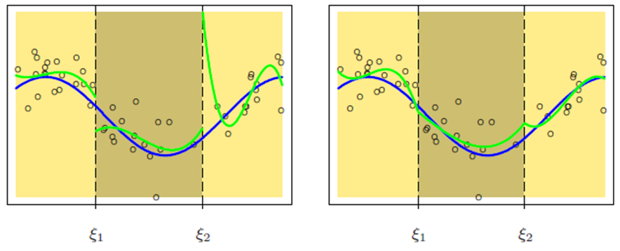
Constraints and Spline
Discontinuous
Uses 12 df (4*3)
Continuous
Uses 10 df (4*3 - 2)

Slide 12
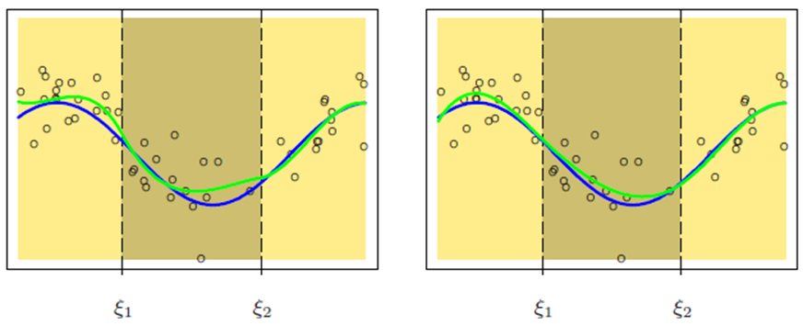
Constraints and Spline
Continuous First Derivative
Uses 8 df (4*3 - 2*2)
Continuous Second Derivative
Uses 6 df (4*3 - 2*3)

Slide 13
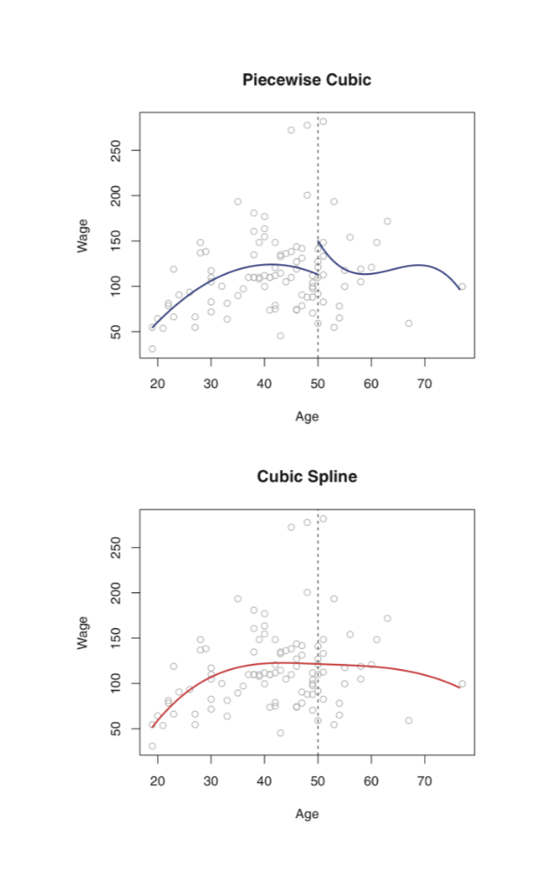
Piecewise Polynomial and Splines
On the left side is an unconstrained piecewise cubic polynomial; on the right side is a cubic spline with continuous first and second derivatives
In other words, the right plot has three additional constraints (continuity, continuity of the first derivative, and continuity of the second derivative)
Quiz: How many df are used in the two graphs above?

Slide 14
Answer & Explanation
Each constraint that we impose on the left plot frees up one df
In the left plot, we use 8 df (4 on each side of the knot) and the right plot uses 5 df (4 on each side of the knot, minus 3, 1 for each constraint)

Slide 15
Regression Spline Definition
The general definition of a degree-d spline is that it is a piecewise degree-d polynomial, with continuity in derivatives up to degree d − 1 at each knot
A degree-d spline with K knots has K + 1 polynomials of degree d, giving (K + 1)(d + 1) coefficients. However, there are d continuity restrictions at each of the K knots, so it uses
(K + 1)(d + 1) - Kd = K + d + 1 degrees of freedom

Slide 16
The Spline Basis Representation
To make a piecewise degree-d polynomial continuous, we can incorporate the continuity constraints on the function and it’s first d - 1 derivatives as additional parameters in our linear model
Recall the Basis Function’s expression:
Using this idea, a cubic spline with K knots can be modeled as
for an appropriate choice of basis functions b1, b2, ...., bK+3. The model can then be fit using least squares

Slide 17

Truncated Power Basis Function
The most direct way to represent a cubic spline is to start off with a basis for a cubic polynomial - namely, x, x², x³ and then add one truncated power basis function per knot
A truncated power basis function is defined as:
where ξ is the knot
Adding a term of the form β₄h(x, ξ) to the model for a cubic polynomial will impose continuity in the first and second derivatives at ξ; a discontinuity will exist in only the third derivative at ξ

Slide 18
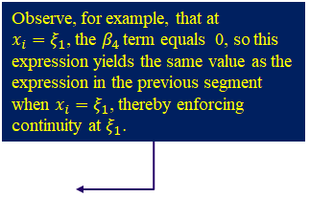
Example
Suppose we wish to model a cubic spline with two knots at 𝜉₁ and 𝜉₂. This is equivalent to modeling y_{i} as follows:
Thus,
𝑊ℎ𝑒𝑛 𝑥 ≤ 𝜉₁, 𝑤𝑒 𝑚𝑜𝑑𝑒𝑙 𝑦_{𝑖} as
𝑊ℎ𝑒𝑛 𝜉₁ ≤ 𝑥 ≤ 𝜉₂, 𝑤𝑒 𝑚𝑜𝑑𝑒𝑙 𝑦_{𝑖} as
𝑊ℎ𝑒𝑛 𝑥 > 𝜉₂, 𝑤𝑒 𝑚𝑜𝑑𝑒𝑙 𝑦_{𝑖} as

Slide 19
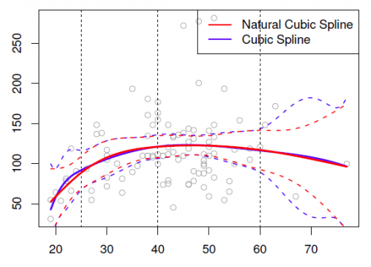
Natural Spline
Splines can have high variance at the outer range of the predictors (where X is smaller than the smallest knot, or larger than the largest knot)
A natural spline adds additional constraints, namely that the function is linear beyond the boundary knots
This frees up four degrees of freedom (two constraints each in both boundary regions), but also uses 2 additional df for endpoint knots, so the equation to calculate df used in a Natural Cubic Spline is df=k+4+2-4=k+2

Slide 20
Pros and Cons of Natural Splines
Pros:
Due to the nature of most datasets that data points are sparse either in the upper or lower region, natural spline usually gives better fit than cubic spline does
Cons:
Since natural spline takes away two extra df, its flexibility decreases as compared to the cubic spline, which might increase the risk of overfitting

Slide 21
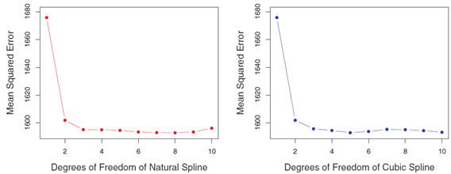
Choose Number & Locations of the Knots
One common practice is to place knots in a uniform fashion
In R, usually set the desired df or number of knot arguments in bs() and ns()
R will automatically place the corresponding number of knots at uniform quantiles of the data (e.g., 25th, 50th, 75th quantile)
Or, strategically place more knots where function might vary most rapidly and place fewer where it seems more stable
Use cross-validation to determine the best number of knots

Slide 22
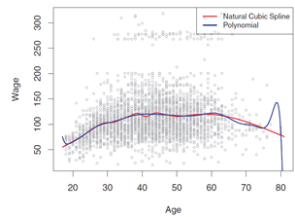
Regression splines v.s. polynomial regression
Regression splines often give superior results to polynomial regression
The figure below compares a natural cubic spline with 15 degrees of freedom to a degree-15 polynomial on the Wage data set

Slide 23
Note on df’s
in Regression Splines and Natural Splines
Degrees of freedom in Regression Splines:
Number of df = (k +1)(d+1) - kd = k + d + 1
For cubic splines, k+4
When specifying df to the bs() function, df=k+3, so k=df-3. If I want 3 internal knots, must specify df=6.
Degrees of freedom in Natural Splines:
df = k+4 (cubic spline) + 2 (endpoint knots) - 4 (2 added constraints for linearity at each end), so df=k+2
When specifying df to the ns() function, df=k+1, so k=df-1. If I want k=3 internal knots, must specify df=4

Slide 24
Code Exercise

